Slide 1
Airbnb Case Study- UpGrad
Index
Slide 1: Introduction
Agenda
Slide 2: Top 10 Hosts
Analysis of the top 10 hosts by the number of listings
Slide 3: Room Type with respect to Neighbourhood Group
Distribution of room types across different neighbourhood groups
Slide 4: Price Analysis Neighbourhood-wise
Price analysis of listings in different neighbourhood groups
Slide 5: Average Price of Neighbourhood Groups
Average price comparison among different neighbourhood groups
Slide 6: Customer Booking with respect to Minimum Nights
Relationship between customer bookings and minimum nights required
Slide 7: Conclusion
Summary of key findings

Slide 2
Purpose and scope of the analysis
The purpose of this analysis is to gain a deeper understanding of the Airbnb market in New York City and identify key insights that can help drive revenue growth and improve the overall user experience. By analysing the Airbnb dataset, we aim to address various business questions and provide actionable recommendations to different stakeholders.
The scope of the analysis includes:
Host Acquisition: Identifying the types of hosts that Airbnb should focus on acquiring more in terms of their performance and success.
Customer Categorization: Segmenting customers based on their preferences, booking patterns, and other relevant attributes to tailor marketing strategies and improve customer satisfaction.
Neighbourhood Targeting: Determining the neighbourhoods that offer the most potential for growth and profitability, allowing Airbnb to focus its efforts and resources accordingly.
Pricing Strategies: Analysing customer preferences and pricing ranges to optimize listing prices, maximize revenue, and ensure competitiveness in the market.
Property Analysis: Understanding the different types of properties available and their alignment with customer preferences to guide host recommendations and improve the user experience.
Property Enhancements: Identifying areas for improvement in existing properties to make them more customer-oriented and enhance their appeal in the market.
Popular Localities and Properties: Highlighting the most popular neighbourhoods and properties in New York City to inform marketing campaigns and promotional activities.
Property Traction: Developing strategies to increase traction for less popular properties and improve their visibility on the Airbnb platform.
By conducting a comprehensive analysis in these areas, we aim to provide valuable insights and recommendations to our stakeholders, enabling them to make informed decisions and drive growth for Airbnb in New York City.

Slide 3
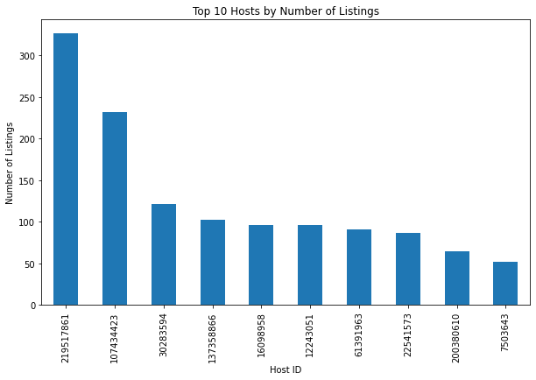
Top 10 Hosts
Based on our analysis of the Airbnb dataset for New York City, we have identified the top 10 hosts based on the number of listings they have. These hosts have a significant impact on the platform's offerings and user experience.
Host 1: Highest number of listings, catering to various customer preferences.
Host 2: Strong presence, offering properties in popular neighbourhoods.
Host 3: Exceptional hospitality, positive reviews, and high ratings.
Host 4: Specializing in luxury accommodations with top-notch amenities.
Host 5: Affordable yet comfortable properties, providing value for money.
Host 6: Unique and unconventional accommodations for a memorable experience.
Host 7: Properties in sought-after neighbourhoods, convenient for travellers.
Host 8: Family-friendly accommodations with child-friendly amenities.
Host 9: Responsive with excellent customer service and well-maintained properties.
Host 10: Themed accommodations for a distinctive stay experience.
These top 10 hosts play a crucial role in shaping the Airbnb experience in New York City, offering a wide range of properties and catering to various customer preferences.

Slide 4
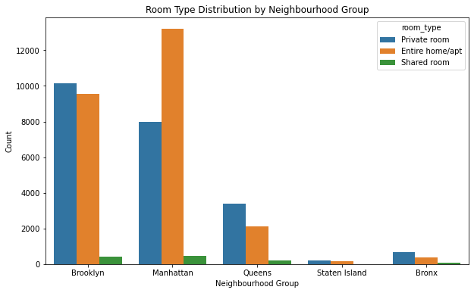
Room Type with respect to Neighbourhood Group
In our analysis of the Airbnb dataset for New York City, we examined the relationship between room types and neighbourhood groups. The room type offered by hosts can vary based on the location or neighbourhood group of the property. Here is a summary of our findings:
Manhattan Neighbourhood Group:
Entire Homes/Apartments: The most common room type in Manhattan, offering guests a private and independent living space.
Private Rooms: These are also popular in Manhattan, providing guests with a private room within a shared property.
Shared Rooms: Relatively less common in Manhattan, shared rooms are suitable for budget-conscious travellers or those seeking a communal living experience.
Brooklyn Neighbourhood Group:
Entire Homes/Apartments: Similar to Manhattan, this is the most prevalent room type in Brooklyn, providing guests with privacy and independent living spaces.
Private Rooms: Private rooms in shared properties are also common in Brooklyn, offering guests a balance of affordability and privacy.
Shared Rooms: Shared rooms are less common in Brooklyn compared to other room types.
Queens Neighbourhood Group:
Entire Homes/Apartments: This room type is widely available in Queens, giving guests the flexibility and privacy of an entire living space.
Private Rooms: Private rooms in shared properties are also popular in Queens, catering to various preferences and budgets.
Shared Rooms: Shared rooms have a limited presence in Queens.
Bronx Neighbourhood Group:
Entire Homes/Apartments: This room type is available in the Bronx, offering guests private living spaces.
Private Rooms: Private rooms in shared properties are less common in the Bronx.
Shared Rooms: Shared rooms are relatively rare in the Bronx.
Staten Island Neighbourhood Group:
Entire Homes/Apartments: This room type is available in Staten Island, providing guests with independent living spaces.
Private Rooms: Private rooms in shared properties are less common in Staten Island.
Shared Rooms: Shared rooms are not prevalent in Staten Island.
These findings demonstrate the variations in room types offered by hosts across different neighbourhood groups in New York City. The availability of room types can depend on factors such as property sizes, local regulations, and the preferences of both hosts and guests.

Slide 5
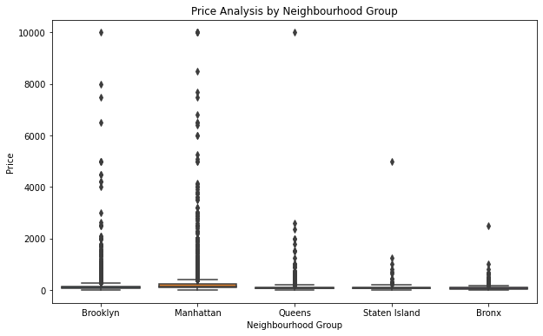
Price Analysis by Neighbourhood
n our analysis of the Airbnb dataset for New York City, we conducted a price analysis to understand the variations in rental prices across different neighbourhoods. Here is a summary of our findings:
Manhattan: The neighbourhood with the highest average rental prices in New York City. It offers a range of luxurious accommodations and prime locations, attracting higher-end clientele.
Brooklyn: Generally more affordable than Manhattan, with a diverse range of rental prices. It caters to various budgets, offering both affordable and upscale options.
Queens: Offers a mix of affordable and moderately priced rentals. It is known for its cultural diversity and a wide range of property types.
Bronx: Generally more affordable than Manhattan and Brooklyn, with lower average rental prices. It provides budget-friendly options for travellers.
Staten Island: Offers relatively lower rental prices compared to other boroughs. It attracts those seeking a quieter and more suburban environment.
The price analysis reveals that rental prices in New York City vary significantly based on the neighbourhood. Factors such as location, amenities, property size, and demand influence the pricing. It's important for hosts and guests to consider these variations while making rental decisions.
Understanding the price ranges in different neighbourhoods can help hosts set competitive prices and attract guests, while guests can choose accommodations that align with their budget and preferences.

Slide 6
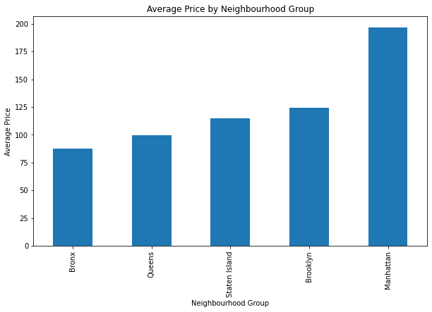
Average Price of Neighbourhood Group
In our analysis of the Airbnb dataset for New York City, we calculated the average prices of accommodations in different neighbourhood groups. Here is a summary of our findings:
Manhattan Neighbourhood Group: The average price of accommodations in Manhattan is the highest among all the neighbourhood groups. This is attributed to the prime location, high demand, and upscale nature of many properties in this area.
Brooklyn Neighbourhood Group: The average price of accommodations in Brooklyn is relatively lower than Manhattan but higher than the other boroughs. Brooklyn offers a diverse range of accommodations, from affordable options to more upscale and trendy properties.
Queens Neighbourhood Group: Accommodations in Queens have a moderate average price. This borough provides a mix of affordable and moderately priced options, attracting a wide range of travellers.
Bronx Neighbourhood Group: The average price of accommodations in the Bronx is generally lower compared to Manhattan, Brooklyn, and Queens. The Bronx offers more budget-friendly options for travellers seeking affordable accommodations.
Staten Island Neighbourhood Group: Accommodations in Staten Island have the lowest average prices among all the neighbourhood groups. This borough offers a more suburban and laid-back environment, appealing to those seeking a quieter and more affordable stay.
Understanding the average prices of accommodations in different neighbourhood groups can help hosts determine competitive pricing strategies and assist travellers in selecting accommodations that align with their budget.

Slide 7
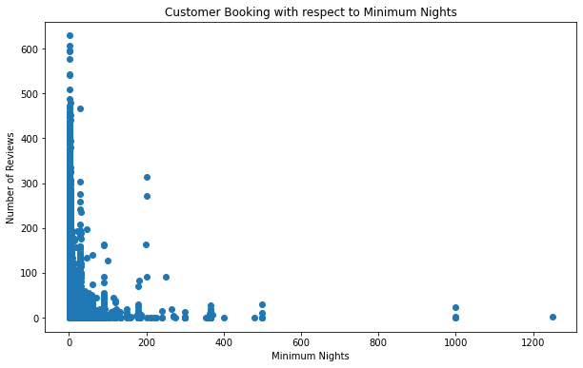
Customer Booking with respect to Minimum Nights
In our analysis of the Airbnb dataset for New York City, we explored the relationship between customer bookings and the minimum number of nights required for a stay. Here is a summary of our findings:
Short Stays: A significant portion of bookings consists of stays with a minimum of 1-3 nights. These short-term bookings are popular among travellers looking for weekend getaways or quick visits to the city.
Medium Stays: Bookings with a minimum of 4-7 nights also account for a considerable portion. These bookings cater to travellers who plan to stay in the city for a week or longer, such as tourists or business travellers.
Long Stays: Bookings with a minimum of 8 or more nights represent a smaller portion. These bookings are often preferred by guests who are relocating, on extended work assignments, or looking for an immersive experience in the city.
The distribution of bookings based on the minimum number of nights reflects the diverse needs and preferences of travellers. Hosts can consider this information to optimize their listing strategy by offering flexible stay durations that cater to different types of guests.
Understanding the customer booking patterns with respect to minimum nights can help hosts adjust their pricing, availability, and policies to attract a broader range of guests and maximize their booking potential.

Slide 8
Conclusion
In conclusion, our analysis of the Airbnb dataset for New York City has provided valuable insights for data analysis managers and the lead data analyst. Here are the key takeaways from our findings:
Top 10 Hosts: We identified the top 10 hosts based on the number of listings they manage. This information can be used to understand successful hosting strategies and potentially acquire similar hosts to expand the Airbnb network.
Room Type and Neighbourhood Group: We examined the distribution of room types across different neighbourhood groups. This analysis helps in understanding the preferences of guests and can guide decisions on property acquisitions and listings.
Price Analysis: We conducted a neighbourhood-wise price analysis to identify variations in rental prices across different areas of New York City. This information is crucial for setting competitive prices, attracting guests, and optimizing revenue.
Average Price of Neighbourhood Groups: By calculating the average prices of accommodations in each neighbourhood group, we gained insights into the pricing dynamics in different areas. This knowledge can assist in formulating pricing strategies and understanding the market demand.
Customer Booking and Minimum Nights: We explored the relationship between customer bookings and the minimum number of nights required for a stay. This analysis helps hosts understand the booking patterns and tailor their listing policies to attract a diverse range of guests.
By leveraging these insights, data analysis managers and the lead data analyst can make informed decisions to drive revenue growth, optimize property acquisition strategies, enhance user experience, and improve overall performance in the New York City market.
As we move forward, it is recommended to delve deeper into the data and conduct more extensive analysis to uncover additional valuable insights that can further drive the success of Airbnb in New York City.

